Slide 1
Determination of Silica in Wheat Leaves with ATR-FTIR-Chemometrics

Slide 2
Contenido
Revisión bibliográfica
Resultados del análisis
Consideraciones parael manuscrito

Slide 3
Computers and Electronics in Agriculture
The journal publishes original papers, reviews, and applications notes on topics pertaining to advances in the use of computers or electronics in plant or animal agricultural production, including agricultural soils, water, pests, controlled environments, structures, and wastes, as well as the plants and animals themselves. Post-harvest operations considered part of agriculture (such as drying, storage, logistics, production assessment, trimming and separation of plant and animal material) are also covered. Relevant areas of technology include artificial intelligence, sensors, machine vision, robotics, networking, and simulation-modelling.
Computers and Electronics in Agriculture provides international coverage of advances in the development and application of computer hardware, software, electronic instrumentation, and control systems for solving problems in agriculture, including agronomy, horticulture (in both its food and amenity aspects), forestry, aquaculture, and animal/livestock farming.

Slide 4
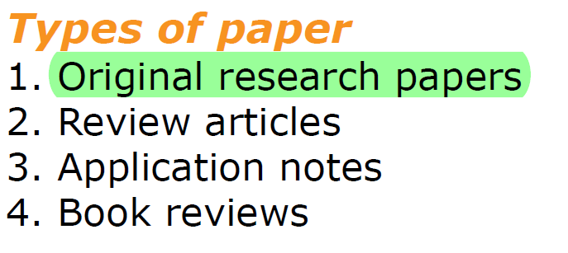
Computers and Electronics in Agriculture
Original research papers should report the results of original research. The material should not have
been previously published elsewhere, except in a preliminary form.

